Slide 1

SEMINAR PRESENTATION
Wearable Computing and Smart Wearable Devices
.
CSA1003
K Madan Mohan
192411206

Slide 2


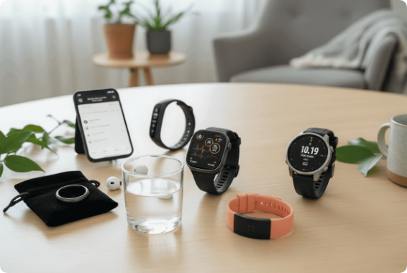
Introduction to Wearable Computing
Wearable Computing: Electronic devices worn directly on the human body or integrated into everyday clothing.
Smart Devices: Equipped with microcontrollers, biosensors, wireless modules, and internal memory for real-time tracking.
Key Difference: Unlike smartphones, wearables collect data hands-free and continuously without user interaction.
Popular Examples: Smartwatches, fitness bands, smart rings, and smart glasses.
Speaker Tip: Emphasize that wearables run silently in the background while staying attached to the user.

Slide 3




Evolution of Wearable Technology
Wearables evolved from basic mechanical tools into sophisticated AI-powered personal assistants over several decades.
1970s - 1980s
1990s - 2000s
2010s
2015 - 2020
Present / Future
Calculator watches & digital wristwatches
Early chest straps & basic pedometers
Fitness trackers (Fitbit, Jawbone Era)
Modern Smartwatches & Smart Glasses
AI Smart Rings, Health Patches & AR/VR
Speaker Tip: Point out how hardware miniaturization made it possible to fit powerful sensors into small wristwear.

Slide 4






Need and Motivation
Continuous Health Care
Hands-Free Convenience
Active Fitness Tracking
Enables 24/7 tracking of vital signs like heart rate, oxygen levels, and sleep patterns for early disease detection.
Allows users to receive calls, view notifications, and navigate without frequently holding a phone.
Encourages healthier lifestyles by setting step goals, tracking burned calories, and guiding workouts.
Safety & Fall Detection
Remote Patient Care
Enhanced Productivity
Detects sudden falls or accidents and sends automated emergency alerts with GPS location to contacts.
Helps doctors monitor elderly or chronic disease patients remotely, reducing unnecessary hospital visits.
Provides instant alerts and voice commands to boost personal efficiency at work or during tasks.
Speaker Tip: Explain that preventive healthcare is the biggest driver behind consumer adoption today.

Slide 5









Working Principle & Architecture
1. Sensors
2. Data Collection
3. On-Board MCU
4. Bluetooth/BLE
5. Mobile / Cloud
6. User Alert
PPG, Accelerometer, ECG
Raw Analog Signals
Signal Filtering
Wireless Transfer
AI Analysis & Storage
App UI & Vibration
Signal Processing
Cloud Synchronisation
Sensors capture physical body parameters (like blood flow or acceleration) and convert them into digital data for processing.
Data is synced wirelessly via Bluetooth Low Energy (BLE) to mobile apps and cloud databases for long-term health trends.
Speaker Tip: Walk through the flow step-by-step: Sensor records body data → MCU filters noise → Transmits via BLE.

Slide 6

Key Hardware Components
Biosensors: Optical PPG (heart rate), ECG electrodes, SpO2 pulse oximeters, and skin temperature sensors.
Motion Sensors: 3-axis Accelerometers, Gyroscopes, and Magnetometers to detect physical steps and activity.
Processing Unit: Low-power Microcontrollers (ARM Cortex-M) optimized for continuous sensor readings.
Connectivity: Bluetooth Low Energy (BLE), Wi-Fi, NFC (for digital payments), and GPS location modules.
Power Source: Compact Lithium-ion/Polymer batteries designed for power efficiency.
Speaker Tip: Highlight that BLE (Bluetooth Low Energy) is essential because normal Bluetooth drains battery quickly.

Slide 7




Types of Smart Wearables
Smartwatches & Fitness Bands
Smart Glasses & AR Headsets
Examples: Apple Watch, Samsung Galaxy Watch, Fitbit. Uses: Step counting, heart rate, workouts, and smartphone notifications.
Examples: Ray-Ban Meta, Google Glass, Apple Vision Pro. Uses: Navigation overlay, hands-free video capture, and augmented reality.
Smart Rings & Jewelry
Smart Clothing & Medical Patches
Examples: Oura Ring, Ultrahuman Ring Air. Uses: Discrete sleep tracking, body temperature monitoring, and recovery scores.
Examples: Sensoria smart socks, Dexcom CGM glucose patches. Uses: Athlete posture analysis and continuous blood sugar monitoring.
Speaker Tip: Smart rings are currently the fastest-growing form factor because they are lightweight and comfortable to wear during sleep.

Slide 8
Real-World Applications
Healthcare & Hospitals
Sports Performance
Workplace Safety
Continuous ECG monitoring flags Atrial Fibrillation (AFib) early; glucose sensors remove need for fingerpricks.
Athletes analyze heart rate variability (HRV), stamina levels, and muscle exertion to optimize daily training.
Industrial workers wear smart helmets to monitor fatigue, toxic gas exposure, and dangerous physical slips.
Defense & Military
Contactless Payments
Education & Research
Field soldiers wear biosensors to track hydration, stress under combat, and precise squad GPS positioning.
Smartwatches and rings use NFC technology to allow secure tap-to-pay transactions at retail stores.
Smart glasses assist medical students during virtual surgical practice with real-time HUD instructions.
Speaker Tip: Mention how Apple Watch AFib notifications have already saved many lives globally.

Slide 9



Advantages and Limitations
Key Advantages
Key Limitations
Real-Time Tracking: Provides immediate feedback on health and activity.
Battery Life Constraints: Requires frequent daily or weekly charging.
High Portability: Lightweight and comfortable for all-day continuous wear.
Data Privacy Risks: Sensitive biometric data can be exposed to breaches.
Personalized Insights: AI learns individual baseline body metrics.
High Cost: Advanced medical-grade wearables are expensive.
Emergency Assistance: Automated SOS calls during accidents or falls.
Sensor Noise: Body motion during vigorous exercise causes signal noise.
Speaker Tip: Be balanced: While benefits are high, battery consumption and privacy are major challenges engineers are actively solving.

Slide 10
Recent Developments and Trends
On-Device AI Assistance
Non-Invasive Glucose Research
Flexible & Electronic Skin
Generative AI summaries of daily health reports and personalized workout advice directly on smartwatches.
Development of optical sensors capable of estimating blood sugar levels without drawing blood drops.
Ultra-thin, stretchable electronic patches that stick directly to skin like temporary tattoos.
Energy Harvesting
Smart E-Textiles
On-Device Edge Computing
Research into charging devices using body heat (thermoelectric) and kinetic arm movements.
Conductive threads woven directly into shirts and jackets to measure breathing and posture seamlessly.
Running lightweight machine learning models locally on microcontrollers to save battery and boost privacy.
Speaker Tip: On-device AI means your watch can analyze health data locally without sending every single file to cloud servers.

Slide 11





Key Technical Challenges
Data Privacy & Security
Power & Form Factor
Biometric information (heart rate, location) is sensitive. Unencrypted Bluetooth transmission can lead to cyber eavesdropping.
Users expect tiny, lightweight devices, but larger batteries are required for multi-day usage and bright displays.
Solution: Implementing end-to-end encryption and lightweight cryptographic protocols on microcontrollers.
Solution: Ultra-low power hardware sleep modes and low-power displays (AMOLED / e-ink).
Sensor Accuracy & Artifacts
Medical Regulatory Approval
Sweat, arm movements, and loose wrist straps create motion artifacts, corrupting optical heart rate calculations.
Transitioning consumer wearables into certified medical diagnostic tools requires strict FDA / CE approval processes.
Speaker Tip: Explain motion artifact: When you run fast, the watch shakes on your wrist, making optical light sensing tricky.

Slide 12




Future Scope of Wearables
Brain-Computer Interfaces (BCI)
Implantable Bio-Sensors
Non-invasive neural headbands translating brainwaves into digital commands to control smart home devices hands-free.
Sub-dermal micro-sensors giving continuous biochemical readings for decades with zero daily maintenance.
Full Ambient Smart Home Integration
Smart Contact Lenses
Wearables automatically adjusting room temperature, lighting, and audio based on the user's detected stress or sleep state.
In-eye displays providing augmented reality navigation overlays while sensing glucose levels from tear fluid.
Speaker Tip: Conclude this slide by noting that wearables will transition from "devices we wear" to invisible computing built into everyday life.

Slide 13

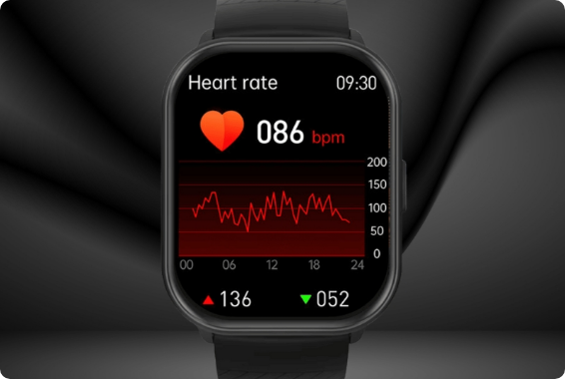
Case Study: Smartwatch Ecosystem
Overview: Devices like the Apple Watch Series or Fitbit Sense act as comprehensive health centers.
Sensors Integrated:
Optical PPG (Heart Rate & Blood Oxygen)
Electrical Heart Sensor (Single-lead ECG)
3-axis Accelerometer & Gyroscope (Fall Detection)
Temperature Sensor & Altimeter
Data Processing: High-frequency sampling processed locally, flagging irregular rhythms (AFib) before cloud backup.
Impact: Shifting healthcare from reactive treatment to proactive daily prevention.
Speaker Tip: Focus on the ECG feature as a concrete example of medical technology miniaturized for consumers.

Slide 14

Data Processing Workflow
Example: How a smartwatch detects an abnormally high resting heart rate and alerts the user.
Step 1: Continuous Data Sensing
Optical PPG green LEDs flash against the wrist skin to measure blood flow volume changes every second.
Step 2: On-Board Microcontroller Analysis
The MCU filters movement noise and calculates current Beats Per Minute (BPM).
Step 3: Threshold Evaluation
If BPM > 120 while accelerometer shows zero physical activity for 10 minutes, an anomaly flag is raised.
Step 4: User Notification & Cloud Sync
Haptic motor vibrates the wrist to warn the user, and event log is synced to the smartphone app for doctor review.
Speaker Tip: Walk through this logical chain to prove you understand how hardware and software work together.

Slide 15


Conclusion
Personal Tech Evolution
Healthcare Transformation
Wearables shift computing closer to the human body, providing seamless hands-free interaction.
Continuous monitoring transforms medicine from periodic check-ups to proactive daily wellness.
Engineering Synergy
Promising Horizon
Combines low-power hardware, biosensors, wireless protocols, and AI algorithms.
Future innovations in e-textiles, energy harvesting, and edge AI will make wearables invisible yet indispensable.
"Wearable technology is moving from simple tracking gadgets toward intelligent, proactive personal computing systems."
Speaker Tip: Reiterate this concluding takeaway statement clearly to end your presentation strongly.

Slide 16

References
MDPI Electronics Survey (2025): "A Comprehensive Survey on Wearable Computing for Mental and Physical Health Monitoring." MDPI Journal of Electronics.
IEEE Communications Surveys & Tutorials: "A Survey of Wearable Devices and Challenges." IEEE Xplore Digital Library.
MDPI Sensors (2021): "Review of Wearable Devices and Data Collection Considerations for Connected Health." MDPI Sensors Journal.
ResearchGate Systematic Review: "Wearable Activity Trackers: A Survey on Utility, Privacy, and Security."
Industry Technical Documentation: Official Developer Guides from Apple HealthKit, Google Fit SDK, and Fitbit Research.
Thank You!
Questions & Answers Session

Slide 17



Image Sources
https://zestyears.com/wp-content/uploads/2025/05/Firefly_Gemini-Flash_Remove-writing-on-the-white-airpod-case.-664888.png
Source: zestyears.com
https://www.allaboutcircuits.com/uploads/articles/ChemPhys_wearable_sensors-2.jpg
Source: www.allaboutcircuits.com
https://cdn.nwe.io/files/x/e6/b9/4fa07b4a540b21b88af17307db18.jpg
Source: www.newswire.com

